Slide 1

Iterators & Sequence Containers
19CSE201 Advanced Programming
Sample Programs

Slide 2
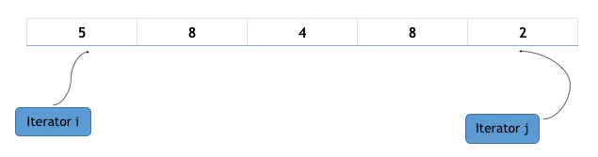
Iterator
Used to point to containers.
Algorithm manipulates data pointed by the iterators.
Syntax
container_type <parameter_list>::iterator iterator_name;

Slide 3
Creating iterators for different types of containers
vector<int>::iterator i;
/* create an iterator named i to a vector of integers */
vector<string>::iterator j;
/* create an iterator named j to a vector of strings */
list<int>::iterator k;
/* create an iterator named k to a list of integers */
map<int, int>::iterator l;
/* create an iterator named l to a map of integers */

Slide 4
Iterators for traversing containers
#include<iostream>
#include<vector>
int main()
{
vector<int> v(10);
/* creates an vector v : 0,0,0,0,0,0,0,0,0,0 */
vector<int>::iterator i;
for(i = v.begin(); i < v.end(); i++)
cout << *i <<" ";
/* in the above for loop iterator I iterates though the
vector v and *operator is used of printing the element
pointed by it. */
return 0;
}

Slide 5
Basic functions on Iterators
advance(iterator i, int distance)-It will increment the value of iterator i by the value of distance.
distance(iterator first, iterator second)-finds the distance between first and second iterators.
next(iterator i, int n)-returns nth element pointed by iterator i.
prev(iterator i,int n)-return nth predecessor to i.
begin()- This method returns an iterator to the start of the given container.
end()-This method returns an iterator to the end of the given container.

Slide 6
Sample program
#include<iostream>
#include<vector>
using namespace std;
int main(){
vector<int> v={5,6,7,8,9,2,3};
vector<int>::iterator i,j;
cout<<"Elements"<<endl;
for(i=v.begin();i<v.end();i++)
{cout<<*i<<" "; }
cout<<endl;
i=v.begin();
advance(i,3);
cout<<"Advance demo:"<<*i<<endl;
j=next(i,2);
cout<<"Next Demo:"<<*j<<endl;
i=v.end();
j=prev(i,7);
cout<<"Prev Demo:"<<*j<<endl;
cout<<"Distance Demo:"<<distance(v.begin(),v.end())<<endl;
return 0;}

Slide 7
Sequence Containers
It implement data structures that can be accessed sequentially.
Sequence container include arrays, vector, and deque.

Slide 8
Sequence Container-Array
Array is a collection of homogenous objects.
Array container in STL help us to implement static array.
This C++ STL array is a kind of sequential container and is not used extremely in regular programming or competitive programming. Still, sometimes it provides an upper edge over the regular normal array that we use in our daily life.
Defined in the header file <array>
Syntax
array<object_type, array_size> array_name;

Slide 9
Basic functions in Array
at()- used to access the elements of an array
get() - This function is also used to access the elements of array. This function is not the member of array class but overloaded function from class tuple.
array_name[]- Also used to access array elements.
front()-returns the first element of an array.
back()-returns the last element of an array.

Slide 10
Basic functions in Array
size()- returns total number of elements in array
swap()- swaps elements between two arrays
empty()-returns true if array is empty
fill()-used to fill the entire array with a particular value

Slide 11
Sample program
#include<iostream>
#include<array>
#include<tuple>
using namespace std;
int main(){
array<int,5>arr={3,5,6,8,9};
for(int i=0;i<5;i++) {
cout<<arr.at(i)<<" "; }
cout<<endl;
cout<<"Element at index 2:"<<get<2>(arr)<<endl;
cout<<"Element at index 3:"<<arr[3]<<endl;
cout<<"First element:"<<arr.front()<<endl;
cout<<"Last element:"<<arr.back()<<endl;
cout<<"No of elements:"<<arr.size()<<endl;
arr.fill(5);
for(int i=0;i<5;i++) {
cout<<arr.at(i)<<" "; }
return 0;}

Slide 12
Sorting an Array
#include <algorithm>
#include <array>
#include <iostream>
#include <iterator>
#include <string>
using namespace std;
int main()
{
array<int, 5> ar1 = {4, 2, 1 , 3, 5};
cout << "Sizes of array are" << endl;
cout << ar1.size() << endl;
cout << "\nInitial ar1 : ";
for (auto i : ar1)
cout << i << ' ';
// By default, the sort() function sorts the elements in ascending order
sort(ar1.begin(), ar1.end());
cout << "\nsorted ar1 : ";
for (auto i : ar1)
cout << i << ‘ ‘;
//Sorting in descending order
sort(ar1.begin(),ar1.end(),greater<int>());
cout << "Array after sorting : \n";
cout<<"\nsorted ar1 : ";
for(auto i : ar1)
cout<<i<<" ";
return 0;
}

Slide 13
Sequence Container-Vector
Vectors are dynamic arrays that resize automatically.
Stored in contiguous memory locations which can be traversed using iterators.
Defined in the header file <vector>.
Since it is dynamic in nature no need to specify the size.
Syntax
vector<data_type>vector_name;

Slide 14
Basic functions in Vector
push_back()- Inserts an element at the end of the vector.
insert(itr,element)- Inserts the element in vector before the position pointed by the iterator itr.
pop_back()- removes an element from the end of vector.
erase(itr_pos)-removes the element pointed by iterator itr.

Slide 15
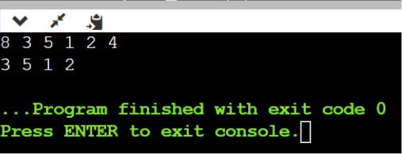
Sample program
#include <iostream>
#include <vector>
using namespace std;
int main()
{
vector<int> v={3,5};
v.push_back(1);
v.push_back(2);
v.push_back(4);
vector<int>::iterator i;
i=v.begin();
v.insert(i,8);
for(i = v.begin(); i < v.end(); i++)
{ cout << *i <<" "; } cout<<endl;
v.pop_back();
v.erase(v.begin());
for(i = v.begin(); i < v.end(); i++)
{
cout << *i <<" ";
}
return 0;
}

Slide 16
Sequence Container-Deque
Double ended queue.
Insertion and deletion at both ends.
May not be at contiguous memory locations.
Defined in <deque> header file.
Syntax
deque< object_type > deque_name;

Slide 17
Basic functions in Deque
push_back()-Inserts at end.
push_front()-Inserts at front.
pop_back()-Delete from end.
pop_front()-Delete from front.

Slide 18
Sample program
#include <iostream>
#include <deque>
using namespace std;
int main()
{deque<int> dq={3,5};
dq.push_back(1);
dq.push_back(2);
dq.push_front(4);
dq.push_front(6);
deque<int>::iterator i;
for(i = dq.begin(); i < dq.end(); i++)
{ cout << *i <<" ";
}cout<<endl;
dq.pop_back();
dq.pop_front();
for(i = dq.begin(); i < dq.end(); i++)
{ cout << *i <<" ";
}}

Slide 19
LIST in STL
Array and Vector are contiguous containers, i.e they store their data on continuous memory.
The insert operation at the middle of vector/array is very costly (in terms of number of operation and process time)
Linked list overcome this problem.
Linked list can be implemented by using the list container.

Slide 20
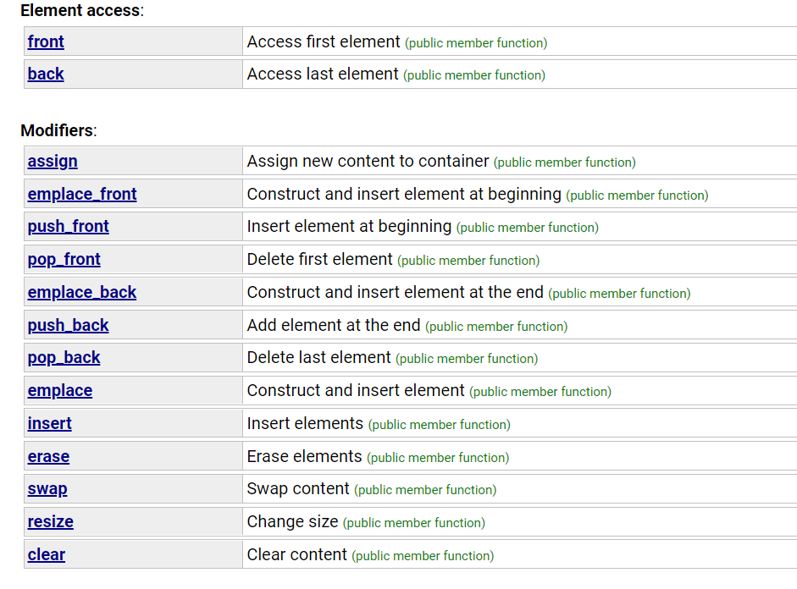
Basic Functions

Slide 21
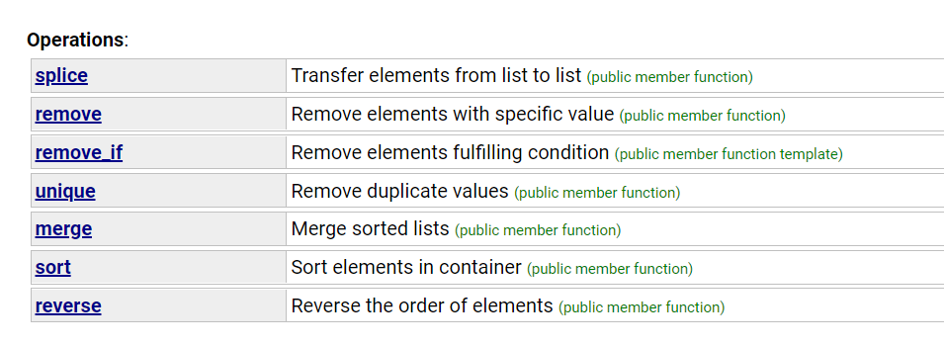
Contd.

Slide 22
Sample Program
​ ​ list1.splice(it, list2);​ /* transfer all elements of list2 at position 2 in list1 */​ /* now list1 is 1 5 6 7 8 2 3 4 and list2 is empty */​ ​ ​ list2.splice(list2.begin(), list1, it);​ /* transfer element pointed by it in list1 to the beginning of list2 */​ /* list2 is now 5 and list1 is 1 6 7 8 2 3 4*/​
​ return 0;​ }​
#include <iostream> #include <list> using namespace std; int main() { list<int> l = {1,2,3,4,5}; list<int>::iterator it = l.begin(); l.insert (it+1, 100); // insert 100 before 2 position /* now the list is 1 100 2 3 4 5 */ l.push_back(6); /* now the list becomes 1,100,2,3,4,5,6*/ l.push_front(8); /* now the list becomes 8,1,100,2,3,4,5,6*/
l.pop_back();
/* now the list becomes 8,1,100,2,3,4,5*/
l.pop_front();
/* now the list becomes 1,100,2,3,4,5*/
list<int> list1 = {1,2,3,4}; list<int> list2 = {5,6,7,8}; list<int>::iterator it; it = list1.begin(); ++it;
//pointing to second position

